Slide 1

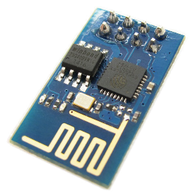


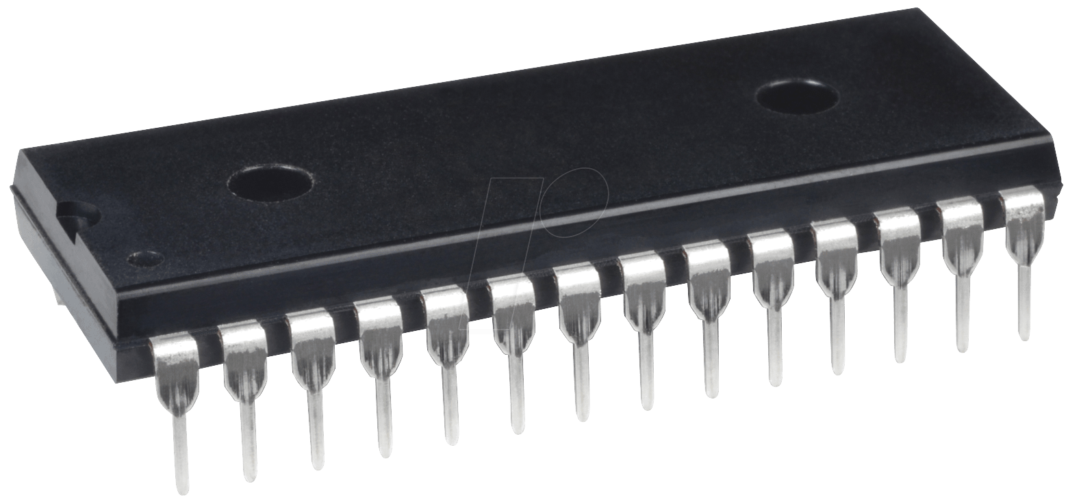

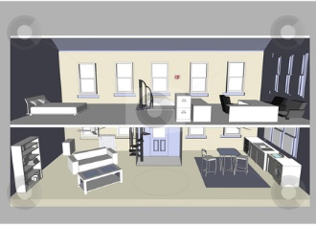
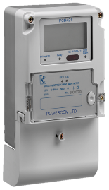
Automated System To Reduce Misuse Of Energy
esp8266
Website
Awareness
Cost effective
Cloud
Control unit
Prevent illegal use of energy
Reduce human effort
atmega328
Use of AI
Suggestions
Data process
User
Home

Slide 2
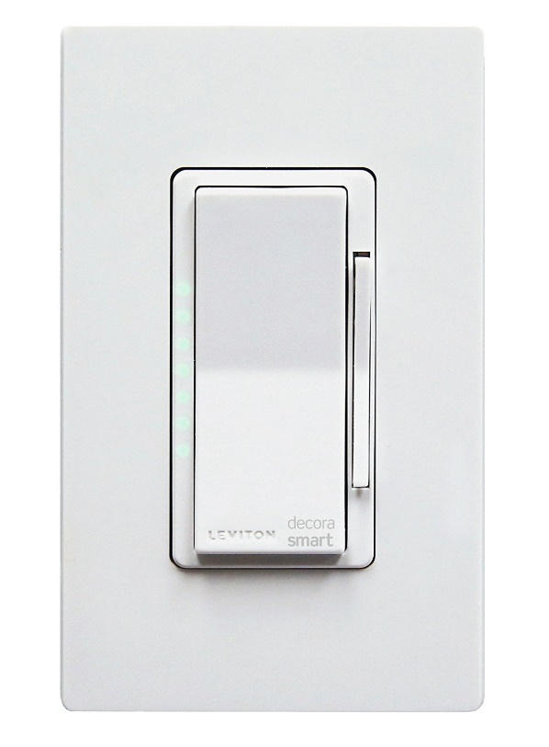
Cost Effective
Leviton DW1KD-1BZ
Price: $49.99

Slide 3
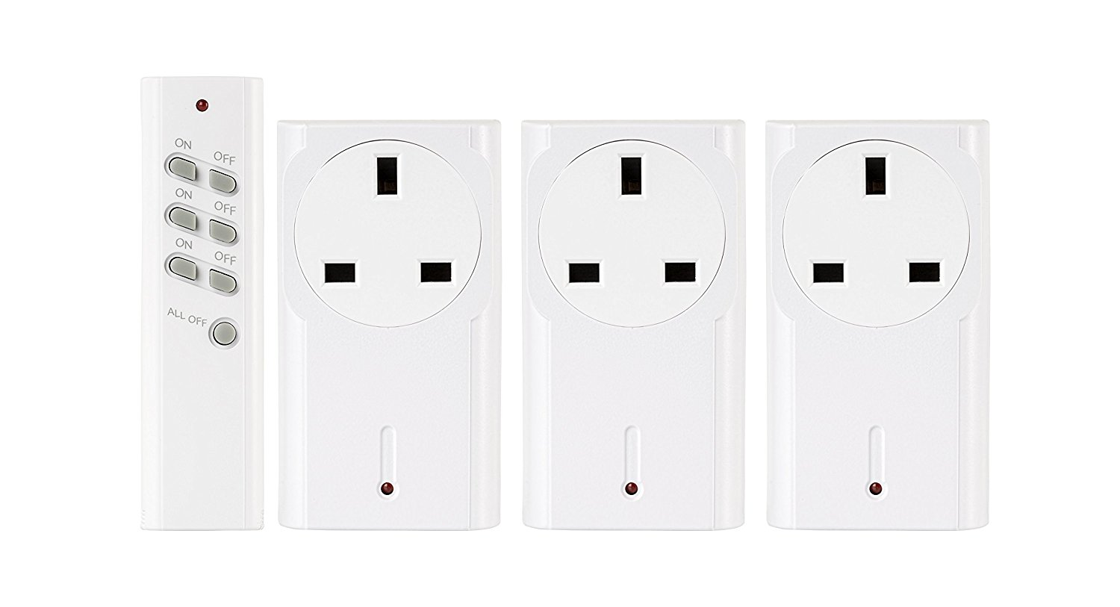
Cost Effective
Trust Smart Home APA3-1500R Starter Kit for Wireless Switching of Lights
Price: £19.99

Slide 4
References
https://www.amazon.co.uk/Trust-Smart-Home-APA3-1500R-Receivers/dp/B015B3RJIG/ref=sr_1_6?ie=UTF8&keywords=Smart+Control+Sockets&qid=1482407681&sr=8-6&tag=tutina-21
https://www.amazon.com/gp/product/B01MS6JDUW/ref=s9_acss_bw_cg_shprod_2a1_w?pf_rd_m=ATVPDKIKX0DER&pf_rd_s=merchandised-search-5&pf_rd_r=4YRZ8SDZBDRKEVFV9QX5&pf_rd_t=101&pf_rd_p=3a581bbf-aa50-4c67-a939-9f4bcf46f1a2&pf_rd_i=13575751011

Slide 5
Items | Costs(TK)
esp8266 | 200/=
atmega328 | 80/=
sensors | 300/=
 | Total=580/=

Slide 6
Items | Misuse
Air Conditioner | 40%-52%
Gas Stove | 50%-64%
Refrigerator | 45%-55%
Lights(Bulbs/Tube lights) | 33%-40%
Fan | 35%-48%
Television | 43%-50%
Iron | 54%-62%

